Slide 1
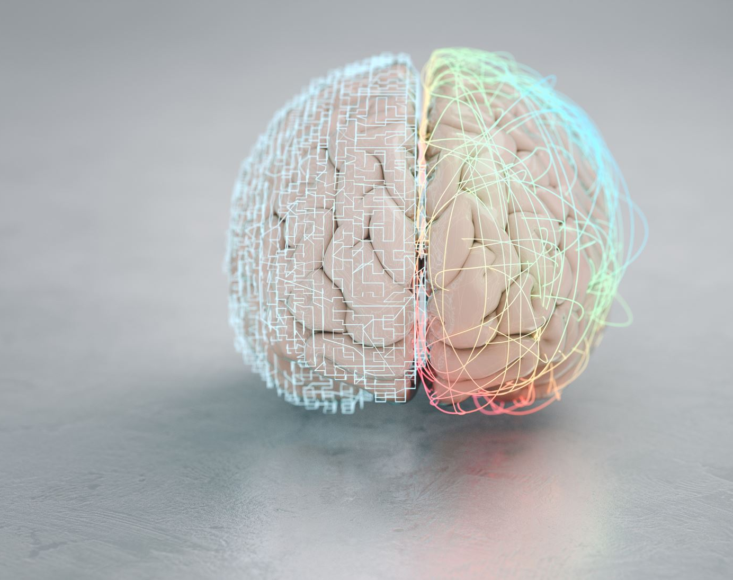
Brain Tumor Detection using Deep Learning Technique(ResNet)
Name:Tulasi Yannam
Id:700746607
Video hyperlink:https://drive.google.com/drive/u/1/my-drive

Slide 2
Motivation
•In the medical field, various computer-added tools are utilized today. The outcome is quick and precise with these tools. The most widely used imaging method for examining the internal structure of the human body is magnetic resonance imaging (MRI)
•A tumor is a cell that grows quickly and uncontrollably. The tumor is typically categorized as benign, malignant, or premalignant. When a tumor is found to be malignant, it becomes cancer. Even in the diagnosis of the most severe medical conditions, such as brain tumors, the MRI is utilized and there are some limitations to it.
•A classifier based on a Convolution Neural Network (CNN) is suggested as a means of overcoming these limitations. The CNN-based classifier (RESNET) compares the trained and test data to arrive at the simplest possible result.

Slide 3
Objectives
•CNN based classifier RESNET compares the trained and test data to arrive at the simplest possible result.
•Residual Netwok (ResNet) uses more layers in a deep neural networks to reduce the error rate and increase the efficiency and accuracy.

Slide 4
Related Work
•Medical imaging techniques, such as Magnetic Resonance Imaging (MRI), Computed Tomography (CT) scan, and Positron Emission Tomography (PET) scan, are commonly used for brain tumor detection.
These imaging modalities can provide detailed cross-sectional images of the brain, allowing radiologists and clinicians to identify abnormalities, such as tumors, based on their size, location, shape, and characteristics.
•Traditional methods of brain tumor detection often rely on manual visual inspection by radiologists, which can be subjective and time-consuming.

Slide 5
Problem Statement
•The current techniques works on manual approach of identifying the tumor and has accuracy issues.
•Brain tumor detection can be challenging due to various factors, including the complexity of brain anatomy, variability in tumor characteristics, overlapping features with normal brain tissues, and potential imaging artifacts.
•Traditional methods of brain tumor detection often rely on manual visual inspection by radiologists, which can be subjective and time-consuming. Therefore, there is a growing interest in developing automated and computer-aided methods for brain tumor detection to improve accuracy, efficiency, and consistency.

Slide 6
Proposed Solution
•Deep learning, specifically convolutional neural networks (CNNs) and Residual Neural Networks (ResNets), has shown promising results in brain tumor detection from medical images. These models can learn complex patterns and features from large datasets, leading to high accuracy and potential for automation.
•These models can learn complex patterns and features from large datasets and make predictions based on the learned representations.
•These approaches often involve preprocessing of medical images, feature extraction, and training of deep learning models using labeled data.

Slide 7
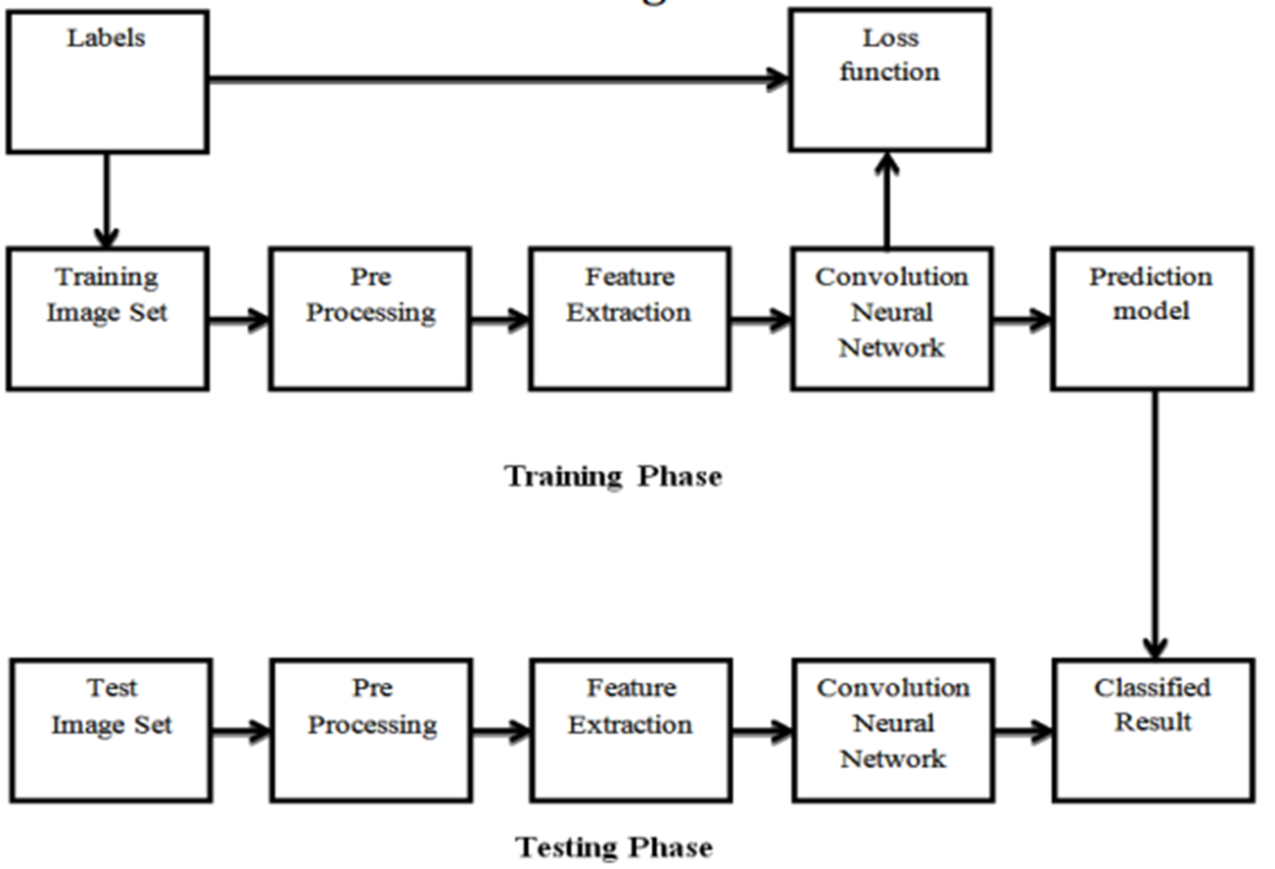
Detail Design
•In the Training Phase we provide the dataset to train the model
•In the Testing Phase we provide the testing dataset to check the accuracy of the model

Slide 8
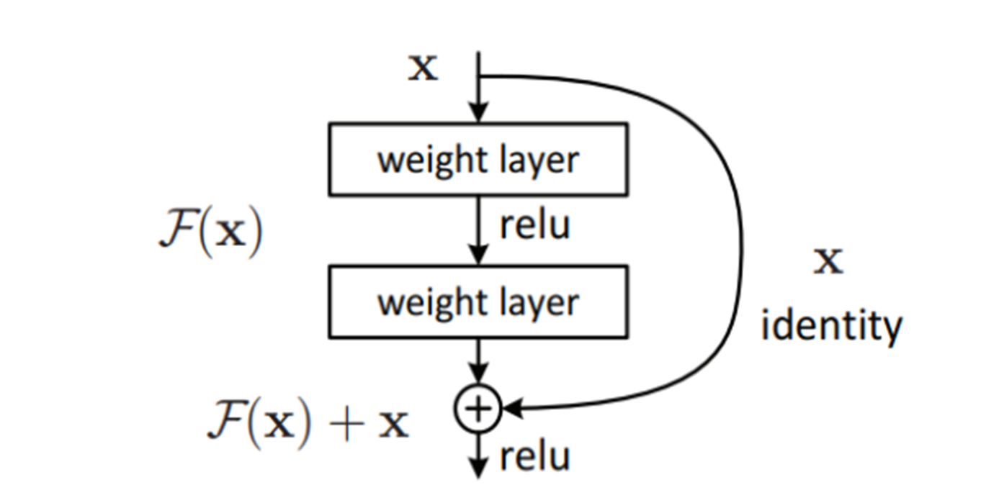
Architecture

Slide 9
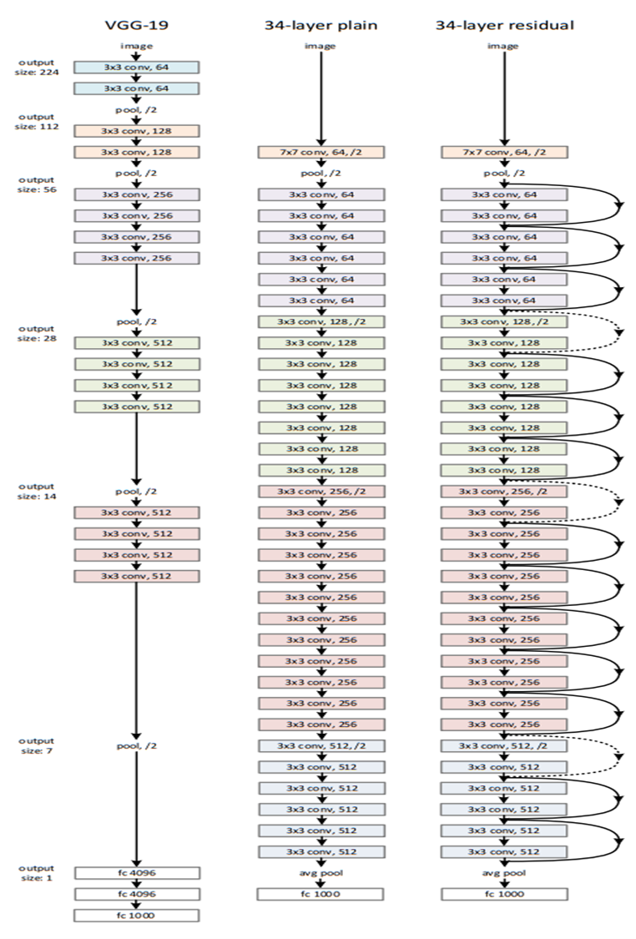
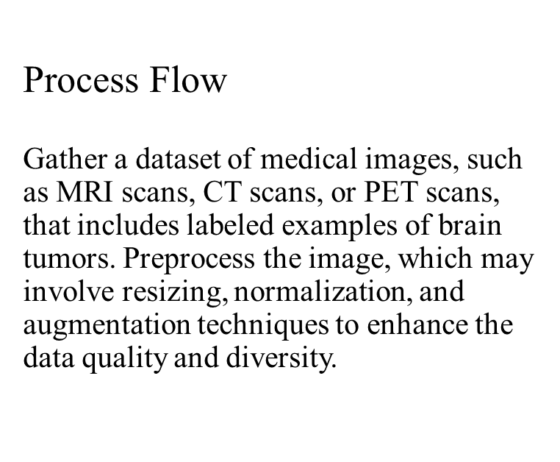

Slide 10
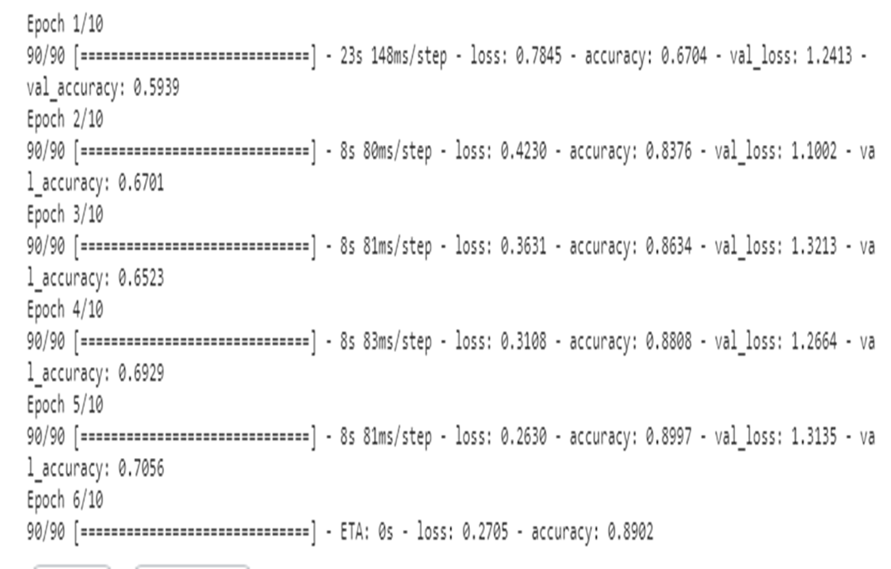
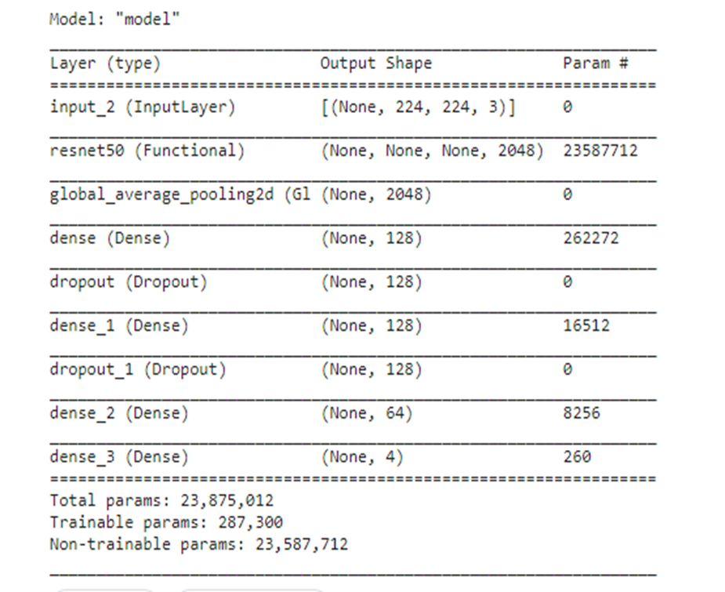
Epochs Model Summary

Slide 11

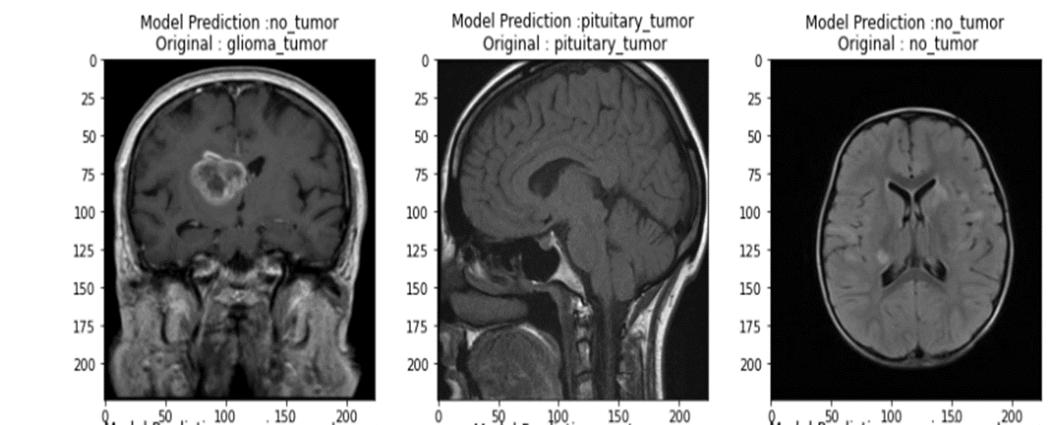
Accuracy

Slide 12
References
•AMRAN HOSSAIN 1 , (Member, IEEE), MOHAMMAD TARIQUL ISLAM 1 , (Senior Member, IEEE), MOHAMMAD SHAHIDUL ISLAM 1 , (Graduate Student Member, IEEE), MUHAMMAD E. H. CHOWDHURY 2 , (Senior Member, IEEE), ALI F. ALMUTAIRI 3 , (Senior Member, IEEE), QUTAIBA A. RAZOUQI3 , (Member, IEEE), AND NORBAHIAH MISRAN 1 , (Senior Member, IEEE) 1Department of Electrical, Electronic and Systems Engineering, Faculty of Engineering and Built Environment, Universiti Kebangsaan Malaysia, Bangi 43600, Malaysia 2Department of Electrical Engineering, Qatar University, Doha, Qatar 3Electrical Engineering Department, Kuwait University, Kuwait City 13060, Kuwait Corresponding authors: Amran Hossain (amranhossain38@gmail.com), Mohammad Tariqul Islam (tariqul@ukm.edu.my), and Ali F. Almutairi (ali.almut@ku.edu.kw)
•MING LI 1 , LISHAN KUANG 2 , SHUHUA XU 2 , AND ZHANGUO SHA 2 1Department of Nuclear Medicine, Rizhao People’s Hospital, Rizhao 276826, China 2Department of Radiology, Rizhao People’s Hospital, Rizhao 276826, China Corresponding author: Zhanguo Sha (shazhanguo@126.com).
•MOHAMMAD ASHRAF OTTOM 1,2, HANIF ABDUL RAHMAN 2,3, AND IVO D. DINOV 2 1Department of Information Systems, Yarmouk University, Irbid 21163, Jordan 2Statistics Online Computational Resource, Departments of Health Behavior and Biological Sciences and Computational Medicine and Bioinformatics, University of Michigan, Ann Arbor, MI 48109, USA 3PAPRSB Institute of Health Sciences, Universiti Brunei Darussalam, Gadong BE1410, Brunei Darussalam CORRESPONDING AUTHOR: MOHAMMAD ASHRAF OTTOM (ottom.ma@yu.edu.jo)
•AHMED H. ABDEL-GAWAD 1 , LOBNA A. SAID 1 , (Senior Member, IEEE), AND AHMED G. RADWAN 2,3, (Senior Member, IEEE) 1Nanoelectronics Integrated Systems Center, Nile University, Giza 12588, Egypt 2Department of Engineering Mathematics and Physics, Cairo University, Giza 12613, Egypt 3School of Engineering and Applied Sciences (EAS), Nile University, Giza 12588, Egypt Corresponding author: Lobna A. Said (l.a.said@ieee.org)

